Slide 1

Bounding Impact on Performance Guarantee with Scaling of Database size in Plan Bouquet
Achint Chaudhary
M.Tech (CSA)

Slide 2
Problem Introduction
“Plan bouquet” is selectivity discovery approach
Subset of POSP plans chosen for ordered execution
Guarantee on worst case Performance bounds

Slide 3
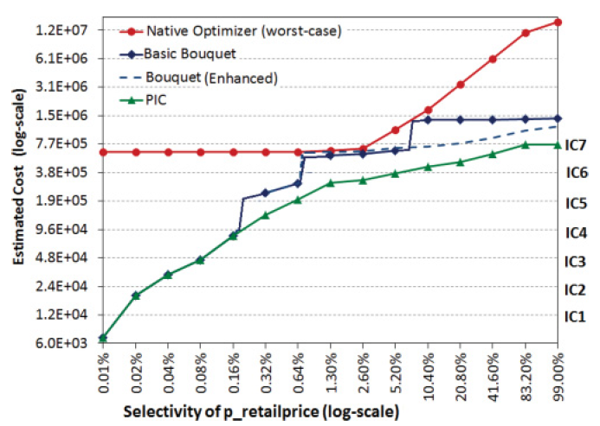



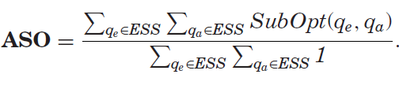

Overview & Robustness Metrics

Slide 4
Challenges w.r.t. Size change
Extension of ESS with significant DB change
Movement of Iso-cost Contours led to change in Contour-Covering SeQUENCES

Slide 5
Implementation Details
Where Optimizer’s abstract unit limits are given for controlled execution.
Impact on join selectivities with different feed for base relations filter

Slide 6
Further Directions
Predicate selection for ESS
Canned vs Ad-Hoc queries
Progressive off-line enumeration

Slide 7
Options During Scale-Up
Re-compilation of entire Bouquet
Providing Relaxation of Performance Guarantee

Slide 8
Approaches looking for
State save, for faster re-compilation
Performance Tolerance on Iso-cost surface shift

Slide 9

Reference Literature
Plan Bouquets: A Fragrant Approach to Robust Query Processing
Platform-independent Robust Query Processing
A Concave Path to Low-overhead Robust Query Processing

